Slide 1
Serial communication interface (8251)

Slide 2
introduction
Most of the microprocessors are designed for parallel communication.
In parallel communication number of lines required to transfer data depend on the number of bits to be transferred.
For example, to transfer a byte of data, 8 lines are required and all 8 bits are transferred simultaneously.
Thus for transmitting data over a long distance, using parallel communication is impractical due to the increase in cost of cabling.
In such situations, serial communication is used. In Serial Communication Interface 8251, one bit is transferred at a time over a single line.

Slide 3
Serial data transmission can be classified on the basis of how transmission occurs.
Simplex
Half duplex
Full duplex
1. Simplex
In simplex, the hardware exists such that data transfer takes place only in one direction. There is no possibility of data transfer in the other direction. A typical example is transmission from a computer to the printer.
2. Half Duplex
The half duplex transmission allows the data transfer in both directions, but not simultaneously. A typical example is a walkie-talkie.

Slide 4
The data in the Serial Communication Interface 8251 may be sent in two formats
3. Full Duplex
The full duplex transmission allows the data transfer in both direction simultaneously. The typical example is transmission through telephone lines.
ASYNCHRONOUS
SYNCHRONOUS
In this, the bits of a character or data word are sent at a constant rate, but characters can come at any rate (asynchronously) as long as they do not overlap.
The start and stop bits in each frame of asynchronous format represents wasted overhead bytes that reduce the overall character rate.

Slide 5
When no characters are being sent, a line stays high at logic 1 called mark, logic 0 is called space.
The beginning of a character is indicated by a start bit which is always low.
This is used to synchronize the transmitter and receiver.
After the start bit, the data bits are sent with least significant bit first, followed by one or more stop bits (active high).
The stop bits indicate the end of character.
The start and stop bits carry no information, but are required because of the asynchronous nature of data.
CONTD
These start and stop bits can be eliminated by synchronizing receiver and transmitter.
Receiver and transmitter can be synchronized by having a common clock signal

Slide 6
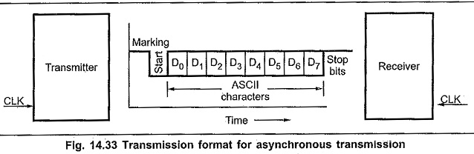
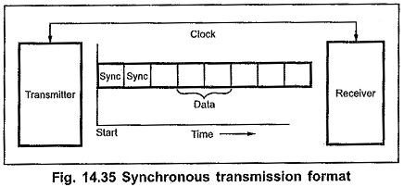

Slide 7
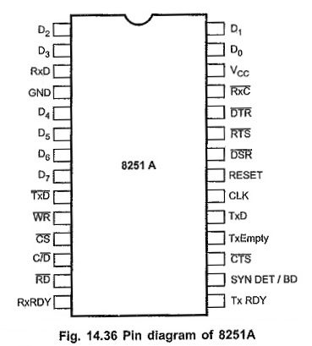
8251 usart
The devices which provides synchronous as well as asynchronous transmission and reception are called universal synchronous asynchronous receiver-transmitter.
A good example of USART is 8251. These devices are software programmable for number of data bits, parity and number of stop bits

Slide 8
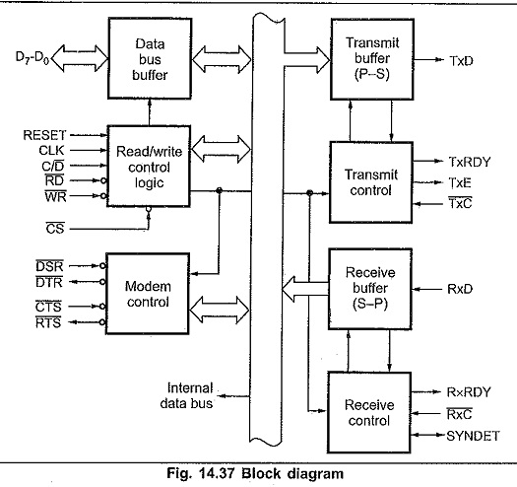
Block diagram

Slide 9
BLOCK DIAGRAM OF 8251
Main blocks:
Data Bus Buffer
Read/Write Control Logic
Transmitter Section
Receiver Section
Modem Control Section

Slide 10
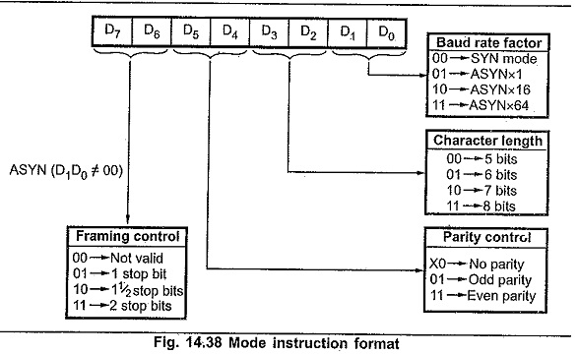
Programming the 8251
The 8251 is programmed using mode word and control word
First reset the 8251 and mode word is sent to control register address followed by control word to same address
The mode word informs the baud rate , parity , character length.
The command word is sent to enable data transmission\reception.
The info regarding readiness of transmitter\receiver and transmission errors are obtained from status word

Slide 11
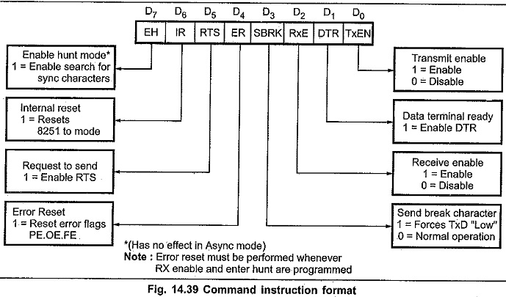
COMMAND WORD

Slide 12
the data communication systems it is often necessary to examine the “status” of the transmitter and receiver. It is also necessary for CPU to know if any error has occurred during communication.
Parity Error : At the time of transmission of data an even or odd parity bit is inserted in the data stream. At the receiver end, if parity of the character does not match with the pre-defined parity, parity error occurs.
Overrun Error : In the receiver section received character is stored in the receiver buffer. The CPU is supposed to read this character before reception of the next character. But if CPU fails in reading the character loaded in the receiver buffer, the next the received character replaces the previous one and the OVERRRUN Error occurs.
Framing Error : If valid stop bit is not detected at the end each character framing error occurs.
All these errors, when occur, set the corrosponding bits in the status register. These error bits are reset by setting ER bit in the command instruction.

Slide 13
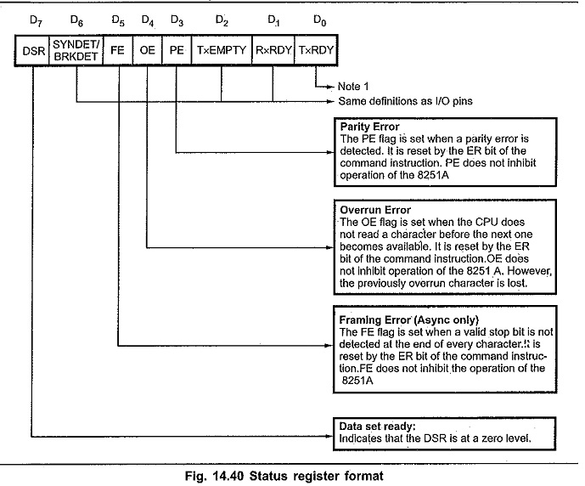
STATUS WORD

